Slide 1
CS4432: Database Systems II
Buffer Manager

Slide 2
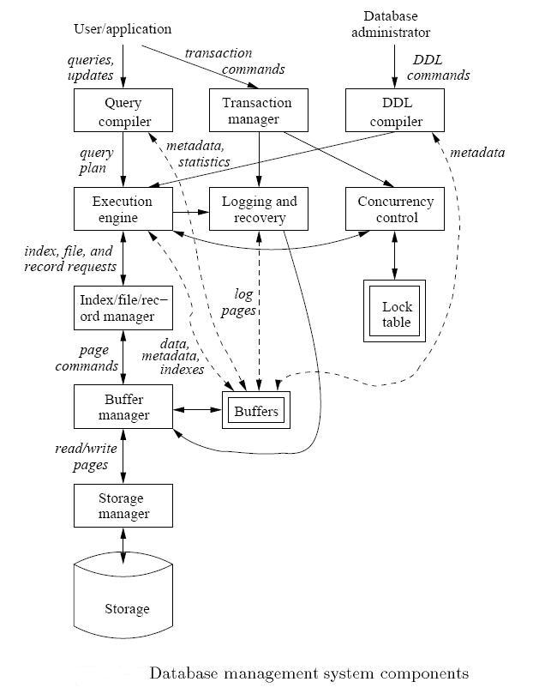
Covered in week 1

Slide 3
Buffer Manager
DB Higher-Level Components (E.g., Query Execution)
Higher-level components do not interact with Buffer Manager
Buffer Manager manages what blocks should be in memory and for how long
Any processing requires the data to be in main memory
Main memory
Buffer Manager
Storage Manager
Disk

Slide 4
Buffer Management in a DBMS
Page Requests from Higher Levels
BUFFER POOL
disk page
free frame
MAIN MEMORY
DISK
choice of frame dictated
by replacement policy
DB
1 2 3 4 5 6 7 8 9 10 11 12 13 14 15 16 … 999
Buffer Pool information table contains: <frame#, disk-pageid, pin_count, dirty>

Slide 5

Some Terminology
Array called “Buffer Pool”
Each entry is called “Frame”
Main Memory
Empty frame
Each entry in the Buffer Pool (Frame) can hold 1 disk block
A disk block in memory is usually called “memory page”
Buffer Manager Keeps track of:
  Which frames are empty
  Which disk page exists in which frame
Used frame (has a page)
Disk
Disk block
(Disk page)
Meta Data Information: <frame#, disk-pageid, pin_count, dirty>

Slide 6
Basic Concepts
Two variables maintained for each frame in buffer pool
  Pin count
    Number of times page in frame has been requested but not released
    Number of current users of the page
    Set to 0 initially
  Dirty bit
    Indicates if page has been modified since it was brought into the buffer pool from disk
    Turned off initially
Notes:
6

Slide 7

Requesting A Disk Page
I need page 3
Higher level DBMS
component
Buf Mgr
BUFFER POOL
MAIN MEMORY
22
disk page
3
I need page 3
3
free frames
Disk Mgr
DISK
1
2
3
…
22
…
90
If requests can be predicted (e.g., sequential scans) pages can be pre-fetched several pages at a time!

Slide 8
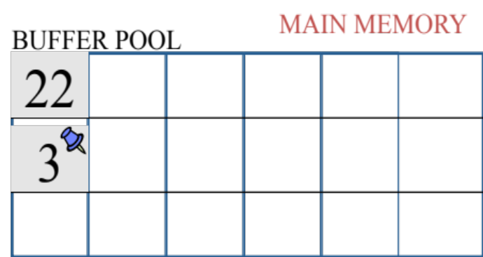
Pin A Memory Page
Pin this page
Can be a flag (T & F)
Can be a counter (0 = unpinned)
Pinning a page means not to take from the memory until un-pinned
Why to pin a page

Slide 9
Why Pin a Page?
Page is in use by a query/transaction
Keep it until the transaction completes
Page is hot and will be needed soon, e.g., root of index trees.
Page is important (referenced a lot)
Recovery & Concurrency control (they enforce certain order)
Log/recovery protocol enforced ordering
Swizzling pointers refer to it

Slide 10
Releasing Unmodified Page
I read page 3 and I’m done with it
Higher level DBMS
component
Buf Mgr
BUFFER POOL
MAIN MEMORY
22
disk page
3
free frames
Unpin the page (if you can)
since page is not modified ➔ Just claim this frame# in free list
No need to write back to disk

Slide 11
Releasing Modified page
I wrote on page 3 and I’m done with it
Higher level DBMS
component
MAIN MEMORY
Buf Mgr
BUFFER POOL
22
disk page
3’
3’
free frames
Disk Mgr
DISK
1
2
3’
3
…
22
…
90

Slide 12
More on Buffer Management
Meta Data Information: <frame#, disk-pageid, pin_count, dirty>
Requestor of page must eventually unpin it, and indicate whether page has been modified:
  dirty bit is used for this.
Page in pool may be requested many times,
  a pin count is used.
  To pin a page, pin_count++
  A page is a candidate for replacement iff pin count == 0 (“unpinned”)
CC & recovery may entail additional I/O when a frame is chosen for replacement.
  Write-Ahead Log protocol; more later!

Slide 13
What if the buffer pool is full? ...
If requested page is not in pool:
  Choose a frame for replacement.
    Only “un-pinned” pages are candidates!
  If frame is “dirty”, write it to disk
  Read requested page into chosen frame
Pin the page and return its address.

Slide 14
When a Page is Requested ...
If requested page is not in pool:
  Choose a frame for replacement
    If a free frame is not available, then choose a frame with pin count = 0
      All requestors of the page in frame have unpinned or released it
  If dirty bit is on, write page to disk
  Read requested page into chosen frame
  Pin the page (increment the pin count)
    A page in pool may be requested many times
  Return address of page to requestor
Notes:
5

Slide 15
Buffer Replacement Policy
Frame is chosen for replacement by a replacement policy:
  Least-recently-used (LRU)
  First-in-First-Out (FIFO),
  Clock Policy
Policy can have big impact on # of I/O’s; depends on the access pattern.
May need additional metadata to be maintained by Buffer Manager

Slide 16
LRU Replacement Policy
Least Recently Used (LRU)
  for each page in buffer pool, keep track of time when last accessed
  replace the frame which has the oldest (earliest) time
  very common policy: intuitive and simple
    Works well for repeated accesses to popular pages
Problems: Sequential flooding
  LRU + repeated sequential scans.
  # buffer frames < # pages in file means each page request causes an I/O.
  Expensive ➔ Each access modifies the metadata

Slide 17
LRU causes sequential flooding in a sequential scan
I need page 1
I need page 2
I need page 3
I need page 4
Higher level DBMS
component
I need page 1
I need page 2…ARG!!!
Buf Mgr
BUFFER POOL
1
4
2
1
3
Disk Mgr
MAIN MEMORY
DISK
1
2
3
4

Slide 18
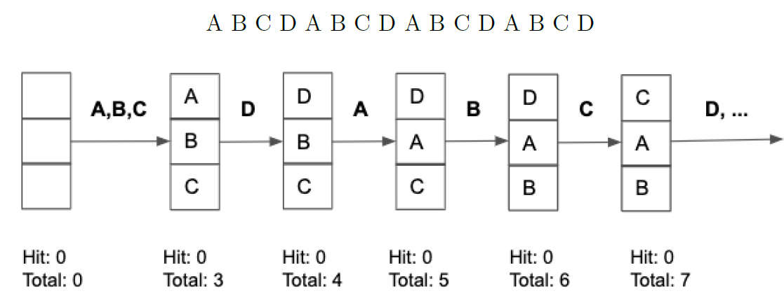
LRU causes sequential flooding in a sequential scan

Slide 19
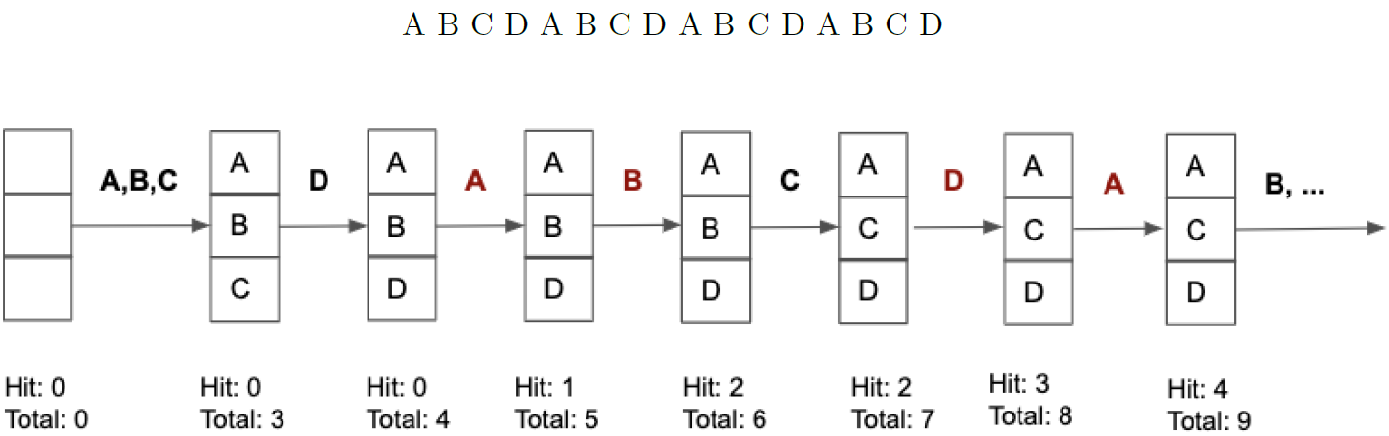
Sequential Scanning Performance - MRU

Slide 20
“Clock” Replacement Policy
Frame 1
An approximation of LRU
Each frame has
  Pin count ➔ If larger than 0, do not touch it
  Second chance bit (Ref) ➔ 0 or 1
Imagine frames organized into a cycle.
A pointer rotates to find a candidate frame to free
Frame 4
Frame 2
Frame 3
IF pin-count > 0 Then ➔ Skip
IF (pin-count = 0) & (Ref = 1) ➔ Set (Ref = 0) and skip ( second chance)
IF (pin-count = 0) & (Ref = 0) ➔ free and re-use

Slide 21
“Clock” Replacement Policy
Frame 1
Higher level DBMS
component
I need page 5
I need page 6
Frame 4
Frame 2
Frame 3
Ref = 1
Buf Mgr
1
5
2
6
3
4
do for each page in cycle {
if (pincount == 0 && ref bit is on)
turn off ref bit;
else if (pincount == 0 && ref bit is off)
choose this page for replacement;
} until a page is chosen;
1
2
3
4
5
6

Slide 22
Back to The Bigger Picture

Slide 23
Relation➔ File ➔ Blocks
Select ID, name, address
From R
Where …
Each relation, e.g., R, has a corresponding heap file storing its data
Catalog tables in DBMS store metadata information about each heap file
  Its block Ids, how many blocks, free spaces

Slide 24
Heap File Using a Page Directory
Data
Page 1
Header
Page
Data
Page 2
Data
Page N
DIRECTORY
The metadata info ➔ directory
Each entry in this directory points to a disk page. It contains
  Block Id, how many records this block hold
  Whether it has free space or not
  Whether the free space is contiguous or not
  …

Slide 25
Records with Disk Pointers

Slide 26
Records with Pointers
Disk
It is not common in relational DBs
But common in object-oriented & object-relational DBs
A data record contains pointers to other addresses on disk
  Either in same block
  Or in different blocks
Block 1
Block 2

Slide 27
Pointer Swizzling
When a block B1 is moved from disk to main memory
  Change all the disk addresses that point to items in B1 into main memory addresses.
  Also pointers to other blocks moved to memory can be changed
  Need a bit for each address to indicate if it is a disk address or a memory address
Why we do that?
  Faster to follow memory pointers (only uses a single machine instruction)

Slide 28
Example of Swizzling
Main Memory
Disk
read B1 into
main memory
swizzled
Block 1
Block 1
unswizzled
Block 2 is still on disk
Block 2

Slide 29
Example of Swizzling
Main Memory
Disk
swizzled
read B1 into
main memory
swizzled
Block 1
Block 1
Block 2
read B2 into
main memory
Block 2

Slide 30
Swizzling Policies
Automatic Swizzling
  As soon as block is brought into memory, swizzle all relevant pointers (if blocks are in memory)
Swizzling on Demand
  Only swizzle a pointer if and when it is actually followed (its block has to move to memory)
No Swizzling
  Do not change the pointer in the memory blocks
  Depend only on a separate Translation Table

Slide 31
Automatic Swizzling
When block B is moved to memory
Locate all pointers within B
  Refer to the schema, which will indicate where addresses are in the records
  For index structures, pointers are at known locations
Swizzle all pointers that refer to blocks in memory
  Change the physical address to main-memory address
  Set the swizzle bit = True
  Update the Translation Table
Physical address | Main-memory address

Slide 32
Automatic Swizzling (Cont’d)
When block B is moved to memory
Pointers referring to blocks still on disk
  Leave them un-swizzled for now
  Add entry for them in the Translation table with empty main-memory address
Check the Translation Table
  If any existing pointer points to B, then swizzle it
  Update the Translation Table
Physical address | Main-memory address
------------- | Null
------------ | Null

Slide 33
Example: Move of B1 to Memory
(Steps 1, 2, 3)
Disk
Main Memory
p1
p2
M1
p2
read B1 into
main memory
swizzled
Block 1
Block 1
unswizzled
Physical address | Main-memory address
P1 | M1
P2 | Null
Block 2

Slide 34
Example: Move of B2 to Memory (Step 4)
Disk
Main Memory
p1
p2
M1
M2
swizzled
read B1 into
main memory
swizzled
Block 1
Block 2
Block 1
read B2 into
main memory
Physical address | Main-memory address
P1 | M1
P2 | M2
Block 2

Slide 35
Unswizzling: Moving Blocks to Disk
When a block is moved from memory back to disk
  All pointers must go back to physical (disk) addresses
Use Translation Table again
Important to have an efficient data structure for the translation table
  Either hash tables or indexes

Slide 36
Question: Which Block is Easier to Move out of memory B1 or B2?
Disk
Main Memory
p1
p2
M1
M2
swizzled
read B1 into
main memory
swizzled
Block 1
Block 2
Block 1
read B2 into
main memory
Physical address | Main-memory address
P1 | M1
P2 | M2
Block 2

Slide 37
Easy Case: Moving Block 1
Disk
Main Memory
p1
p2
M1
M2
swizzled
Move B1 to
disk
swizzled
Block 1
Block 2
Block 1
Use the Translation Table to convert M1 & M2 to P1 & P2
Write B1 to disk
Physical address | Main-memory address
P1 | M1
P2 | M2

Slide 38
Harder Case: Moving Block B2
Main Memory
Approach 1 (Pin Block)
A block with incoming pointers should be pinned in the memory buffer
In that case, B2 cannot be removed from memory until the incoming pointers are removed
M1
M2
swizzled
swizzled
Block 1
Block 2
Physical address | Main-memory address
P1 | M1
P2 | M2

Slide 39
Harder Case: Moving Block B2
Main Memory
Approach 2 (Unswizzle)
Check Translation Table
All incoming pointers should be unswizzled (back to disk addresses)
Update Translation Table
Remove B2 from memory
M1
p2
M2
swizzled
swizzled
Block 1
Block 2
Physical address | Main-memory address
P1 | M1
P2 | M2

